Slide 1
2006 DEMO

Slide 2

Agenda
-Background
-Main functions
-System & Object design
-Live demo
-Conclusion

Slide 3
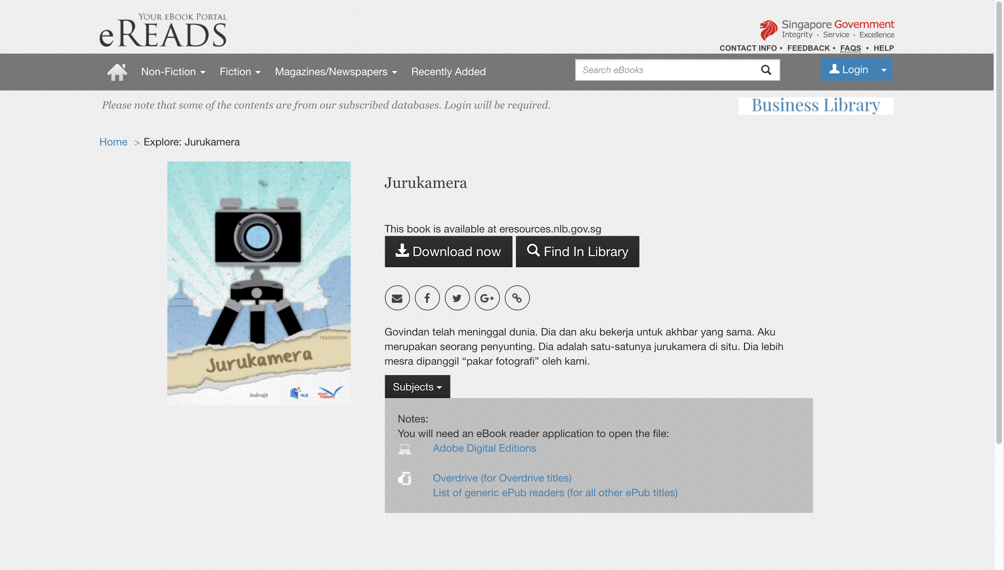
Background
Government API: National Library Board READ! Singapore Short Stories.
120 books, refreshed weekly.

Slide 4
Extra APIs used during development
Facebook API: Link with Facebook account.
Picasso: Load images from Facebook account.
JSoup: Web Scraping.
Epublib: Parse documents of EPUB format.
Tamilutillib: UTF-8 to Tamil string conversion to display Tamil fonts on Android.
Parceler: object instances passing between different Android activities.

Slide 5
Main Functions
Create Account & Login with email of Facebook account
Search
Trending & Recommendations
Read
Thoughts (posted by the user and the user’s facebook friends)
Profile management

Slide 6
System & Object design (jeko)
SE Principles Used:
Single Responsibility Principle
Open-Closed Principle
Don’t Repeat Yourself Principle
Design Patterns Used:
Façade Design Pattern
Adapter Design Pattern

Slide 7
SE Principle Used : Single Responsibility Principle
“There should never be more than ONE reason for a class to change”
EpubDownload
BookInfo

Slide 8
SE Principle Used : Open-Closed Principle
“A module should be open for extension but closed for modification”.
Download Interface

Slide 9
SE Principle Used : Don’t Repeat Yourself Principle
Principle of SE aimed at reducing repetition of software patterns.
Throughout the code

Slide 10
Design Pattern Used : Façade Design Pattern
Provides unified interface to set of interfaces in a subsystem
Intent

Slide 11
Design Pattern Used : Adapter Design Pattern
The adapter pattern convert the interface of a class into another interface that the clients expect.
Adapter lets classes work together that couldn’t otherwise because of incompatible interfaces.
RecyclerView - Adapter - ViewHolder

Slide 12
Demo (1st part)
Create a new account
Set profile ( nickname and self description)
Choose interested subjects
Light recommends particular books according to users’ interests and the most popular books
View users’ personal profile and log out

Slide 13
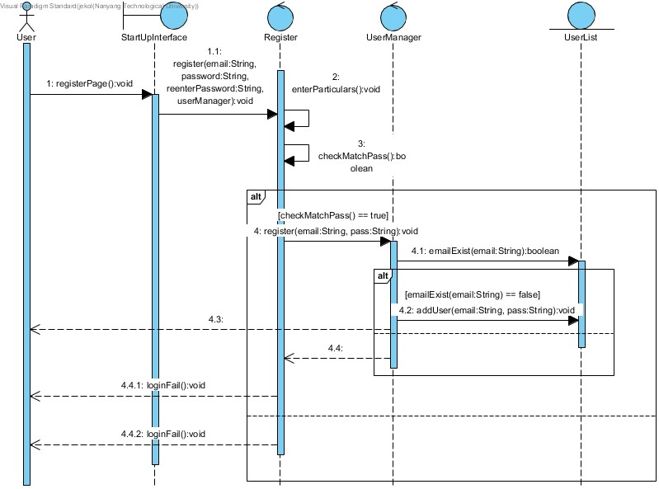
Demo
Notes:
first part:create account→set profile→choose subject(select&deselect)-recommendation/ranking-profile-logout
login same account(click rememeb password)-library-search(specific book)-book detail(description/reviews)-read now-reading-add to shelf(trends ranking)-go to shelf-
(second part)several posts-pull to refresh-logout
facebook login(see the password is remembered)-post-pull to refresh-click delete button-pull to refresh-profile image-logout

Slide 14
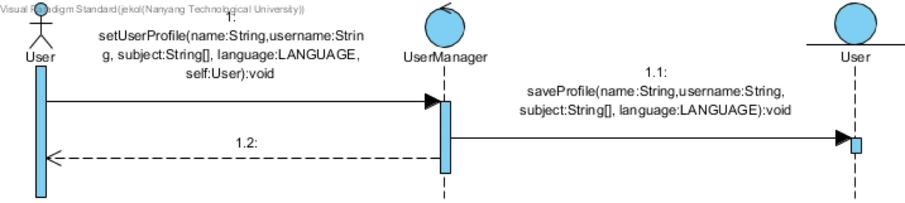

Slide 15
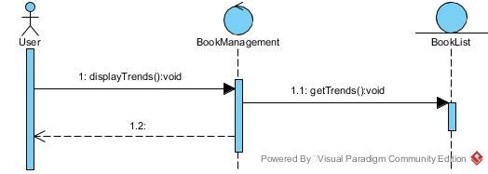

Slide 16
Demo (2nd part)
Login to the app using an existing account.
Go to the library page to view the library.
Search a book and go to its detail page.
Read the book and add the book to the bookshelf.

Slide 17


Slide 18
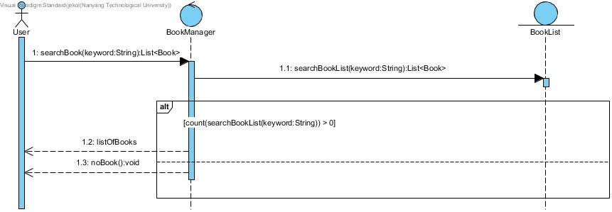
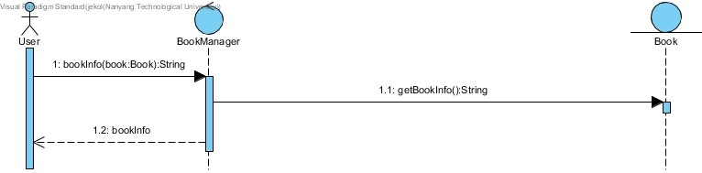
Demo

Slide 19
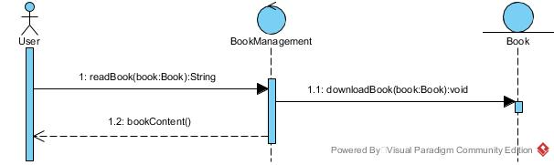
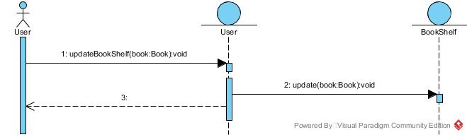
Demo

Slide 20
Demo (3rd part)
Use the current account to post three thoughts. Delete one of the thoughts. Pull to refresh to see each update. Log out of the current account.
On the login page, the remembered password button is clicked. Username and password are remembered.
Facebook login. Post three thoughts. See the difference of delete icon existence for thoughts from different users. Delete one post. Pull to refresh to see each deletion.
Check the profile page that our facebook photo is displayed. Finally logout.
Notes:
Explain my thoughts. The relationship between friends and thoughts. The lasted thought would be at the top. The thought from friends would have higher priority than thoughts from others. Explain color of the thoughts are randomly changed due to each update.

Slide 21
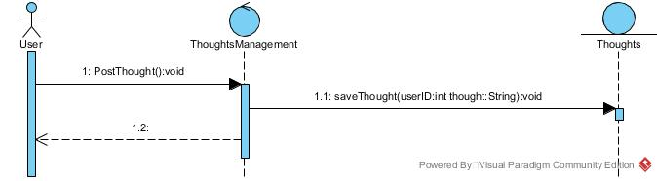
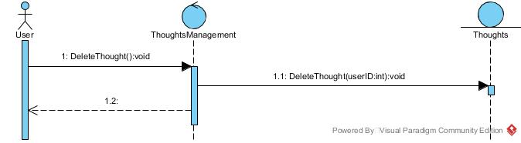

Slide 22
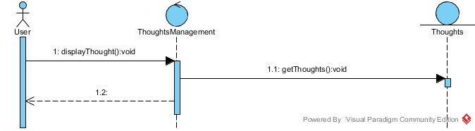

Slide 23

Let books become your best friends!

